Slide 1
CSSE 332 Memory: Paging
Monday, January 28, 2019

Slide 2
Questions
How does paging address the problems in segmentation?
What exactly is a page? frame? page table?
How do we translate a virtual address to a physical address?
How does the operating system handle page faults?

Slide 3
Segmentation: Problems
Unfortunately, segmentation suffers from a major problem:
External fragmentation: the variable sized segments leads to many tiny holes
We can compact segments, but that is expensive
Operating System
(free)
Code
Data
(free)
Stack
(free)
Heap

Slide 4
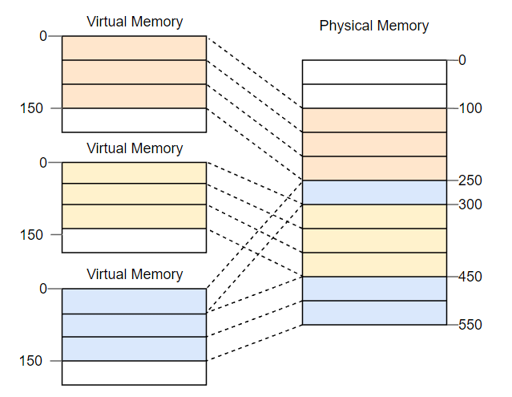
Paging: Overview
Rather than chop memory up into variable sized pieces, paging uses fixed-sized units called pages:
Each process has an address space that consists of fixed-size pages
Each page maps to a physical space frame (of the same size)

Slide 5
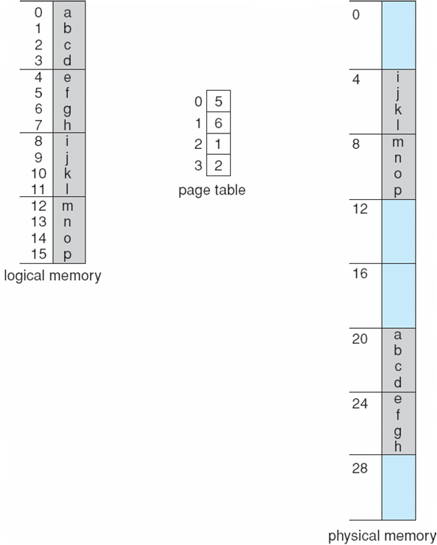
Paging: Address translation
Address generated by CPU is divided into:
Page number (p) – used as an index into a page table which contains base address of each page in physical memory
Page offset (d) – combined with base address to define the physical memory address that is sent by the MMU
Maximum page number = 2^{l} and page size 2^{m}
page number
page offset
l - m
m

Slide 6
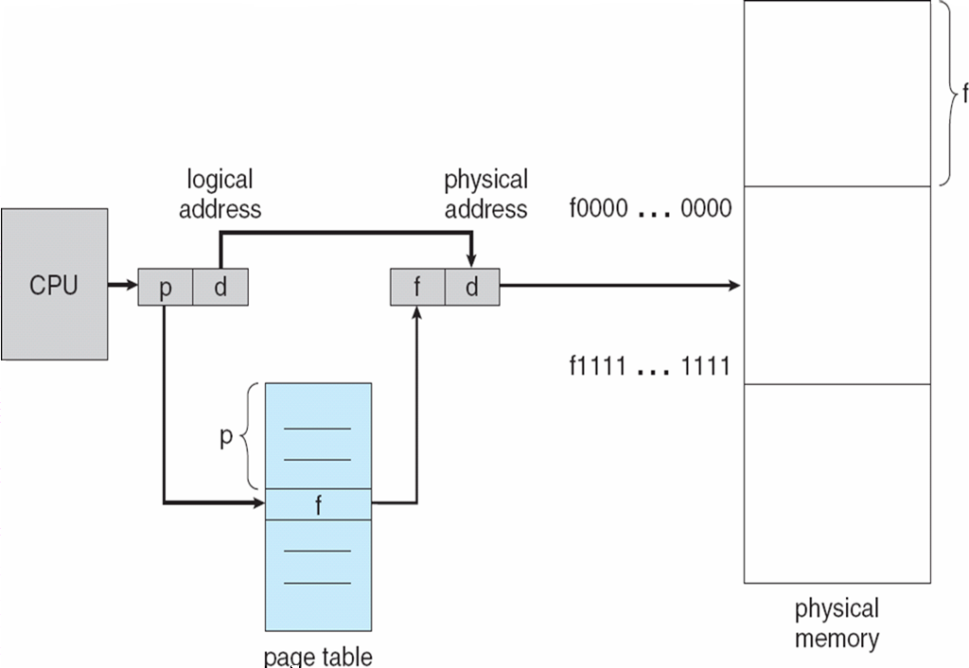
Paging: Address translation (cont.)

Slide 7
Paging: Address Translation
Given the virtual address, 36, answer the following questions:
10 0100 VPN Offset
Which page is this address located?
Which page frame is this address located?
What is the offset of this address?
What is the physical address?
0
16
32
48
64
80
96
112
128
Operating System
Frame 0
(Unused)
Frame 1
Page 3 of AS
Frame 2
Page 0 of AS
Frame 3
(Unused)
Frame 4
Page 2 of AS
Frame 5
(Unused)
Frame 6
Page 1 of AS
Frame 7
Notes:
Page 2
Page Frame 5
4
80 + 4

Slide 8
Paging: Memory Usage
Suppose we had a 32-bit machine with 4KB pages:
How many pages can a process have? 2³² / 2⁽² ⁺ ¹⁰⁾ = 2²⁰ ~ A million
How many bits do we need for the VPN? 20 bits
How many bits do we need for the offset? 12 bits
How large is the page table (assuming each PTE is 4 bytes)? 4 * 2²⁰ = 2²² = 4MB

Slide 9
Paging: Page Table
Each process has a page table that stores the address translations for each virtual page to the corresponding physical frame.
The address of page table is stored in a special register.
In addition to the translation, each page table entry (PTE) may contain the bits of information above.
Bit | Information
Valid | Is the translation valid?
Protection | Can we read, write, execute data in page?
Present | Is the page in physical memory?
Reference | Has page been accessed?

Slide 10
Paging: Problems
Internal Fragmentation: Imagine a program of size 101 in the above example: It would still need three pages of size 50, so it would occupy 49 bytes more than needed.

Slide 11
Paging: Problems
While better than segmentation when it comes to external fragmentation, paging suffers from the following problems:
Overhead: Because each process requires a page table and each table can be quite large, paging incurs high memory usage
Indirection: Because each memory access requires us to lookup the corresponding PTE, we need to perform two physical memory accesses per virtual address

Slide 12
Page Fault
If a page is not present in physical memory, then the hardware triggers a page fault that the operating system handles.
If page is not present and has been swapped to disk, then OS looks up location in PTE and loads it from swap space
(Invalid page fault) If a page fault occurs for a reference to an address that is not part of the virtual address space.
If there are no free page frames in physical memory, then we need to evict one so we can replace it

Slide 13
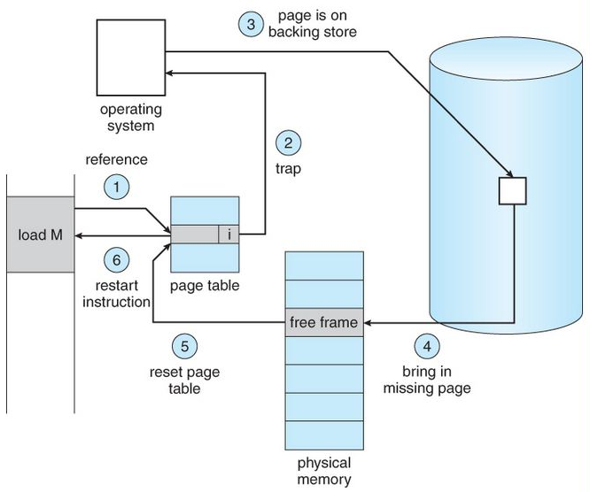
Handle Page Fault

